Slide 1
File Management

Slide 2
Topics
Overview
File Organization and Access
File Allocation Strategies
File Directories
File Sharing

Slide 3
File Concept
A file is a named collection of related information that is recorded on secondary storage.
From a user's perspective, a file is the smallest allotment of logical secondary storage
Types: File is an abstract data type (acts as a layer of abstraction over the secondary storage)
Data
numeric
character
binary
Program
Contents defined by file’s creator
Many types
Consider text file, source file, executable file
Notes:
Data cannot be written to secondary storage unless they are within a file.
Commonly, files represent programs (both source and object forms) and data.
Data files may be numeric, alphabetic, alphanumeric, or binary.
Files may be free form, such as text files, or may be formatted rigidly.
In general, a file is a sequence of bits, bytes, lines, or records the meaning of which is defined by the file’s creator and user. The concept of a file is thus extremely general.
file has a certain defined structure which depends on its type.
A text file is a sequence of characters organized into lines (and possibly pages).
A source file is a sequence of subroutines and functions, each of which is further organized as declarations followed by executable statements.
An object file is a sequence of bytes organized in to blocks understandable by the system's linker. An executable file is a series of code sections that the loader can bring into memory and execute.

Slide 4
Desirable properties of files
Long-term existence
files are stored on disk or other secondary storage and do not disappear when a user logs off
Sharable between processes
files have names and can have associated access permissions that permit controlled sharing
Structure
files can be organized into hierarchical or more complex structure to reflect the relationships among files

Slide 5
File Systems
Provide a means to store data organized as files as well as a collection of functions that can be performed on files
Maintain a set of attributes associated with the file
Typical operations include:
Create
Delete
Open
Close
Read
Write

Slide 6
Example
Open(Fi) – search the directory structure on disk for entry Fi, and move the content of entry to memory
Close (Fi) – move the content of entry Fi in memory to directory structure on disk

Slide 7
File Attributes
Name – only information kept in human-readable form
Identifier – unique tag (number) identifies file within file system
Type – needed for systems that support different types
Location – pointer to file location on device
Size – current file size
Protection – controls who can do reading, writing, executing
Time, date, and user identification – data for protection, security, and usage monitoring
Information about files are kept in the directory structure, which is maintained on the disk
Many variations, including extended file attributes such as file checksum
Information kept in the directory structure

Slide 8

File Organization and Access

Slide 9
File Organization Types
Five of the common file organizations are:
The pile
The sequential file
The indexed sequential file
The indexed file
The direct, or hashed, file

Slide 10
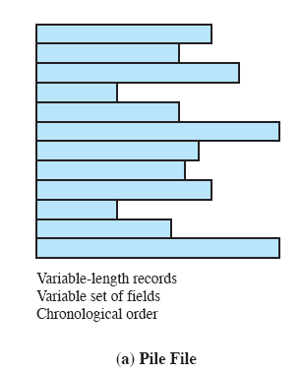
The Pile
Least complicated form of file organization
Data are collected in the order they arrive
Each record consists of one burst of data
Purpose is simply to accumulate the mass of data and save it
Record access is by exhaustive search
Notes:
The least-complicated form of file organization may be termed the pile .
Data are collected in the order in which they arrive.
Each record consists of one burst of data.
The purpose of the pile is simply to accumulate the mass of data and save it.
Records may have different fields, or similar fields in different orders. Thus, each field should be self-describing, including a field name as well as a value. The length of each field must be implicitly indicated by delimiters, explicitly included as a subfield, or known as default for that field type.
Because there is no structure to the pile file, record access is by exhaustive search. That is, if we wish to find a record that contains a particular field with a particular value, it is necessary to examine each record in the pile until the desired record is found or the entire file has been searched. If we wish to find all records that contain a particular field or contain that field with a particular value, then the entire file must be searched.
Pile files are encountered when data are collected and stored prior to processing or when data are not easy to organize. This type of file uses space well when the stored data vary in size and structure, is perfectly adequate for exhaustive searches, and is easy to update. However, beyond these limited uses, this type of file is unsuitable for most applications.

Slide 11
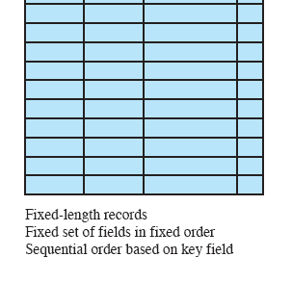
The Sequential File
Most common form of file structure
A fixed format is used for records
Key field uniquely identifies the record & determines storage order
Typically used in batch applications
Only organization that is easily stored on tape as well as disk
Notes:
The most common form of file structure is the sequential file.
In this type of file, a fixed format is used for records.
All records are of the same length, consisting of the same number of fixed-length fields in a particular order.
Because the length and position of each field are known, only the values of fields need to be stored; the field name and length for each field are attributes of the file structure.
One particular field, usually the first field in each record, is referred to as the key field .
The key field uniquely identifies the record; thus key values for different records are always different. Further, the records are stored in key sequence: alphabetical order for a text key, and numerical order for a numerical key.
Sequential files are typically used in batch applications and are generally optimum for such applications if they involve the processing of all the records (e.g., a billing or payroll application). The sequential file organization is the only one that is easily stored on tape as well as disk.
For interactive applications that involve queries and/or updates of individual
records, the sequential file provides poor performance.
Access requires the sequential search of the file for a key match. If the entire file, or a large portion of the file, can be brought into main memory at one time, more efficient search techniques are possible.
Nevertheless, considerable processing and delay are encountered to access a record in a large sequential file. Typically, a sequential file is stored in simple sequential ordering of the records within blocks. That is, the physical organization of the file on tape or disk directly matches the logical organization of the file.

Slide 12
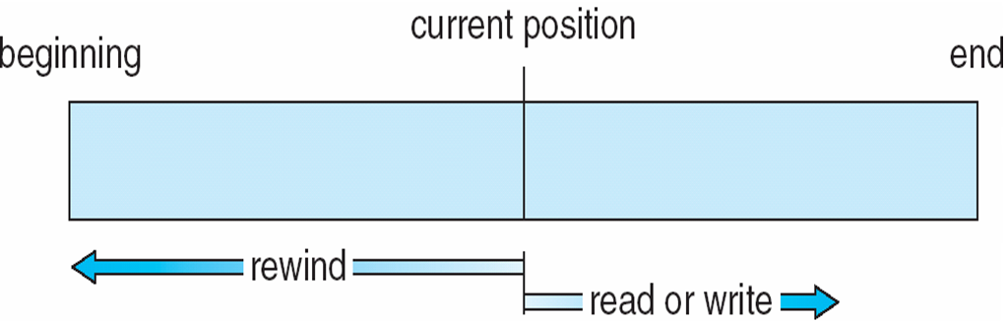
The Sequential File

Slide 13
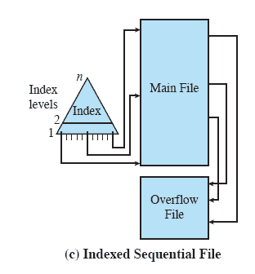
Indexed Sequential File
Adds an index to the file to support random access
Adds an overflow file
Greatly reduces the time required to access a single record
Multiple levels of indexing can be used to provide greater efficiency in access
Notes:
A popular approach to overcoming the disadvantages of the sequential file is the
indexed sequential file.
The indexed sequential file maintains the key characteristic of the sequential file: Records are organized in sequence based on a key field.
Two features are added: an index to the file to support random access, and an overflow
file.
The index provides a lookup capability to reach quickly the vicinity of a desired record.
The overflow file is similar to the log file used with a sequential file but is integrated so that a record in the overflow file is located by following a pointer from its predecessor record.
In the simplest indexed sequential structure, a single level of indexing is used.
The index in this case is a simple sequential file. Each record in the index file consists of two fields: a key field, which is the same as the key field in the main file, and a pointer into the main file.
To find a specific field, the index is searched to find the highest key value that is equal to or precedes the desired key value. The search continues in the main file at the location indicated by the pointer.
To see the effectiveness of this approach, consider a sequential file with
1 million records. To search for a particular key value will require on average one-half
million record accesses. Now suppose that an index containing 1,000 entries
is constructed, with the keys in the index more or less evenly distributed over
the main file. Now it will take on average 500 accesses to the index file followed
by 500 accesses to the main file to find the record. The average search length is
reduced from 500,000 to 1,000.
Additions to the file are handled in the following manner: Each record in
the main file contains an additional field not visible to the application, which is a
pointer to the overflow file. When a new record is to be inserted into the file, it is
added to the overflow file. The record in the main file that immediately precedes
the new record in logical sequence is updated to contain a pointer to the new record
in the overflow file. If the immediately preceding record is itself in the overflow file,
then the pointer in that record is updated. As with the sequential file, the indexed
sequential file is occasionally merged with the overflow file in batch mode.
The indexed sequential file greatly reduces the time required to access a single
record, without sacrificing the sequential nature of the file. To process the entire file
sequentially, the records of the main file are processed in sequence until a pointer
to the overflow file is found, then accessing continues in the overflow file until a null
pointer is encountered, at which time accessing of the main file is resumed where it
left off.
To provide even greater efficiency in access, multiple levels of indexing can be
used. Thus the lowest level of index file is treated as a sequential file and a higher level
index file is created for that file. Consider again a file with 1 million records.
A lower-level index with 10,000 entries is constructed. A higher-level index into
the lower-level index of 100 entries can then be constructed. The search begins at
the higher-level index (average length = 50 accesses) to find an entry point into the
lower-level index. This index is then searched (average length = 50) to find an entry
point into the main file, which is then searched (average length = 50). Thus the average
length of search has been reduced from 500,000 to 1,000 to 150.

Slide 14
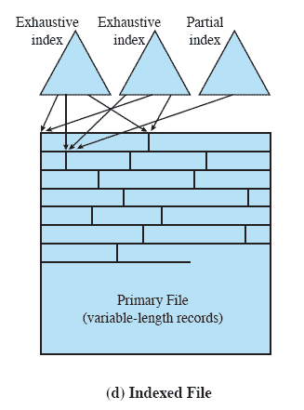
Indexed File
Records are accessed only through their indexes
Variable-length records can be employed
Exhaustive index contains one entry for every record in the main file
Partial index contains entries to records where the field of interest exists
Used mostly in applications where timeliness of information is critical
Examples would be airline reservation systems and inventory control systems
Notes:
The indexed sequential file retains one limitation of the sequential file: Effective
processing is limited to that which is based on a single field of the file.
For example, when it is necessary to search for a record on the basis of some other attribute than
the key field, both forms of sequential file are inadequate.
In some applications, the flexibility of efficiently searching by various attributes is desirable.
To achieve this flexibility, a structure is needed that employs multiple indexes, one for each type of field that may be the subject of a search.
In the general indexed file, the concept of sequentially and a single key are abandoned.
Records are accessed only through their indexes. The result is that there is now no restriction
on the placement of records as long as a pointer in at least one index refers to that record. Furthermore, variable-length records can be employed.
Two types of indexes are used. An exhaustive index contains one entry for every record in the main file. The index itself is organized as a sequential file for ease of searching.
A partial index contains entries to records where the field of interest exists. With variable-length records, some records will not contain all fields.
When a new record is added to the main file, all of the index files must be updated.
Indexed files are used mostly in applications where timeliness of information is critical and where data are rarely processed exhaustively. Examples are airline reservation systems and inventory control systems.

Slide 15
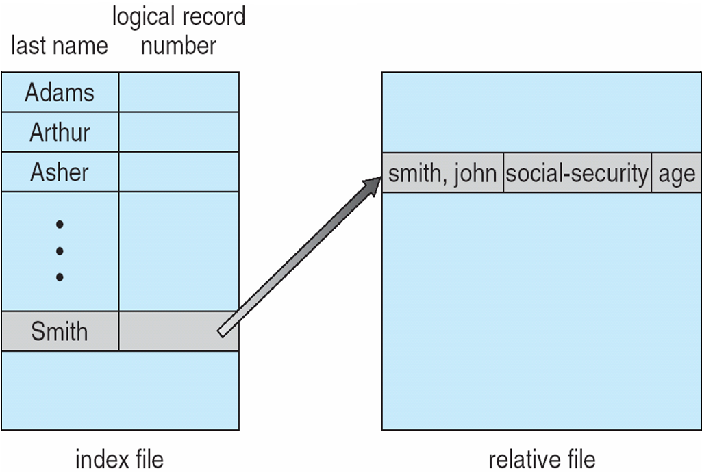
Indexed File
Notes:
With large files, the index file itself may become too large to be kept in memory.
One solution is to create an index for the index file. The primary index file would contain pointers to secondary index files, which would point to the actual data items.
For example, IBM's indexed sequential-access method (ISAM)
uses a small master index that points to disk blocks of a secondary index.
The secondary index blocks point to the actual file blocks. The file is kept sorted on a defined key. To find a particular item, we first make a binary search of the master index, which provides the block number of the secondary index. This block is read in, and again a binary search is used to find the block containing the desired record. Finally, this block is searched sequentially. In this way, any record can be located from its key by at most two direct-access reads.

Slide 16
Direct or Hashed File
file is fixed length logical records
Access directly any block of a known address
Makes use of hashing on the key value
Often used where:
very rapid access is required
fixed-length records are used
records are always accessed one at a time
Examples are:
directories
pricing tables
schedules
name lists
Notes:
The direct, or hashed, file exploits the capability found on disks to access directly any
block of a known address.
As with sequential and indexed sequential files, a key field is required in each record. However, there is no concept of sequential ordering here.
The direct file makes use of hashing on the key value.
Direct files are often used where very rapid access is required, where fixed length records are used, and where records are always accessed one at a time.
Examples are directories, pricing tables, schedules, and name lists.

Slide 17
File allocation strategies
The allocation methods define how the files are stored in the disk blocks.
There are three main disk space or file allocation methods.
Contiguous/Sequential Allocation
Linked Allocation
Indexed Allocation
The main idea behind these methods is to provide:
Efficient disk space utilization.
Fast access to the file blocks

Slide 18
Contiguous Allocation
In this scheme, each file occupies a contiguous set of blocks on the disk.
For example, if a file requires n blocks and is given a block b as the starting location, then the blocks assigned to the file will be: b, b+1, b+2,……b+n-1. This means that given the starting block address and the length of the file (in terms of blocks required), we can determine the blocks occupied by the file.
The directory entry for a file with contiguous allocation contains
Address of starting block
Length of the allocated portion.

Slide 19
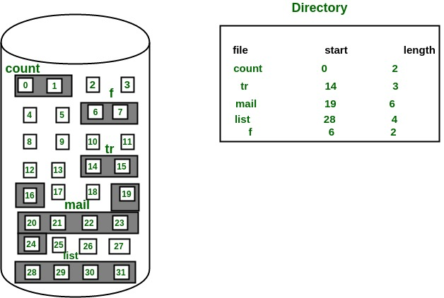
Contiguous Allocation
The file ‘mail’ in the following figure starts from the block 19 with length = 6 blocks. Therefore, it occupies 19, 20, 21, 22, 23, 24 blocks.

Slide 20
Contiguous Allocation
Advantages:
Both the Sequential and Direct Accesses are supported by this. For direct access, the address of the kth block of the file which starts at block b can easily be obtained as (b+k).
This is extremely fast since the number of seeks are minimal because of contiguous allocation of file blocks.

Slide 21
Contiguous Allocation
Disadvantages:
This method suffers from both internal and external fragmentation. This makes it inefficient in terms of memory utilization.
Increasing file size is difficult because it depends on the availability of contiguous memory at a particular instance.

Slide 22
Linked List Allocation
In this scheme, each file is a linked list of disk blocks which need not be contiguous. The disk blocks can be scattered anywhere on the disk.
The directory entry contains a pointer to the starting and the ending file block. Each block contains a pointer to the next block occupied by the file.

Slide 23
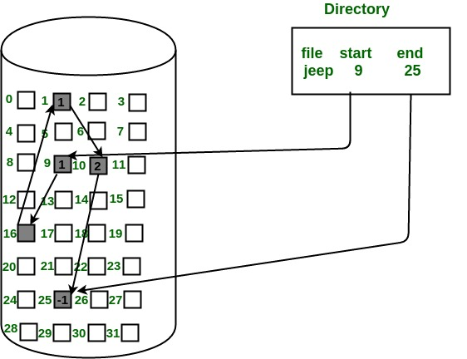
Linked List Allocation
The file ‘jeep’ in following image shows how the blocks are randomly distributed.
The last block (25) contains -1 indicating a null pointer and does not point to any other block.

Slide 24
Linked List Allocation
Advantages:
This is very flexible in terms of file size. File size can be increased easily since the system does not have to look for a contiguous chunk of memory.
This method does not suffer from external fragmentation. This makes it relatively better in terms of memory utilization.

Slide 25
Linked List Allocation
Disadvantages:
Because the file blocks are distributed randomly on the disk, a large number of seeks are needed to access every block individually. This makes linked allocation slower.
It does not support random or direct access. We can not directly access the blocks of a file. A block k of a file can be accessed by traversing k blocks sequentially (sequential access ) from the starting block of the file via block pointers.
Pointers required in the linked allocation incur some extra overhead.

Slide 26
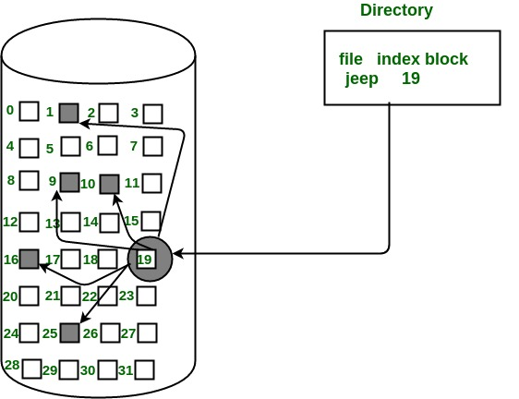
Indexed Allocation
In this scheme, a special block known as the Index block contains the pointers to all the blocks occupied by a file.
Each file has its own index block.
The ith entry in the index block contains the disk address of the ith file block.
The directory entry contains the address of the index block.

Slide 27

Indexed Allocation
Advantages:
This supports direct access to the blocks occupied by the file and therefore provides fast access to the file blocks.
It overcomes the problem of external fragmentation.

Slide 28
Indexed Allocation
Disadvantages:
The pointer overhead for indexed allocation is greater than linked allocation.
For very small files, say files that expand only 2-3 blocks, the indexed allocation would keep one entire block (index block) for the pointers which is inefficient in terms of memory utilization. However, in linked allocation we lose the space of only 1 pointer per block.

Slide 29
Solution
For files that are very large, single index block may not be able to hold all the pointers.
Following mechanisms can be used to resolve this:
Linked scheme:
This scheme links two or more index blocks together for holding the pointers. Every index block would then contain a pointer or the address to the next index block.
Multilevel index
In this policy, a first level index block is used to point to the second level index blocks which in turn points to the disk blocks occupied by the file. This can be extended to 3 or more levels depending on the maximum file size.

Slide 30
Solution
Following mechanisms can be used to resolve this:
Combined Scheme:
In this scheme, a special block called the Inode (information Node) contains all the information about the file such as the name, size, authority, etc and the remaining space of Inode is used to store the Disk Block addresses which contain the actual file.
The first few of these pointers in Inode point to the direct blocks i.e the pointers contain the addresses of the disk blocks that contain data of the file.
The next few pointers point to indirect blocks. Indirect blocks may be single indirect, double indirect or triple indirect.
Single Indirect block is the disk block that does not contain the file data but the disk address of the blocks that contain the file data.
Similarly, double indirect blocks do not contain the file data but the disk address of the blocks that contain the address of the blocks containing the file data.

Slide 31
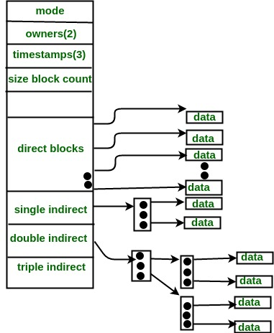
Inode

Slide 32
Directory Structure
A collection of nodes containing information about all files
Both the directory structure and the files reside on disk
Directory
Files
F 1
F 2
F 3
F 4
F n

Slide 33
Disk Structure
Disk can be subdivided into partitions
Disks or partitions can be RAID protected against failure
Disk or partition can be used raw – without a file system, or formatted with a file system
Partitions also known as minidisks, slices
Entity containing file system known as a volume
Each volume containing file system also tracks that file system’s info in device directory or volume table of contents
As well as general-purpose file systems there are many special-purpose file systems, frequently all within the same operating system or computer
Notes:
Redundant Array of Independent/Inexpensive Disks (RAID) is a technology that allows storing data across multiple hard drives. The purpose of RAID is to achieve data redundancy to reduce data loss and, in a lot of cases, improve performance.

Slide 34
Operations Performed on Directory
Search for a file
Create a file
Delete a file
List a directory
Rename a file
Traverse the file system
Notes:
Search for a file. We need to be able to search a directory structure to find the entry for a particular file. Since files have symbolic names, and similar names may indicate a relationship between files, we may want to be able to find all files whose names match a particular pattern.
Create a file. New files need to be created and added to the directory.
Delete a file. When a file is no longer needed, we want to be able to remove it from the directory.
List a directory. We need to be able to list the files in a directory and the contents of the directory entry for each file in the list.
Rename a file. Because the name of a file represents its contents to its users, we must be able to change the name when the contents or use of the file changes. Renaming a file may also allow its position within the directory structure to be changed.
Traverse the file system. We may wish to access every directory and every file within a directory structure. For reliability, it is a good idea to save the contents and structure of the entire file system at regular intervals. Often, we do this by copying all files to magnetic tape. This technique provides a
backup copy in case of system failure. In addition, if a file is no longer in use, the file can be copied to tape and the disk space of that file released
for reuse by another file.

Slide 35
Directory Organization
The directory is organized logically to obtain
Efficiency – locating a file quickly
Naming – convenient to users
Two users can have same name for different files
The same file can have several different names
Grouping – logical grouping of files by properties, (e.g., all Java programs, all games, …)

Slide 36
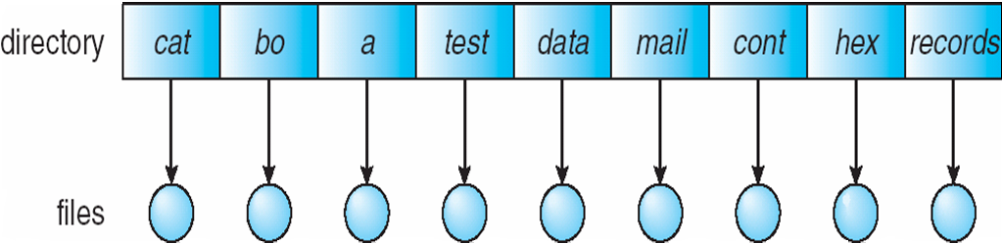
Single-Level Directory
A single directory for all users
Naming problem
Grouping problem
Notes:
The simplest directory structure is the single-level directory. All files are contained in the same directory, which is easy to support and understand
A single-level directory has significant limitations, however, when the number of files increases or when the system has more than one user. Since all files are in the same directory, they must have unique names.
If two users call their data file test, then the unique-name rule is violated.
For example, in one programming class, 23 students called the program for their second assignment prog2; another 11 called it assign2.
Although file names are generally selected to reflect the content of the file, they are often limited in length, complicating the
task of making file names unique.
Even a single user on a single-level directory may find it difficult to remember the names of all the files as the number of files increases. It is not uncommon for a user to have hundreds of files on one computer system and an
equal number of additional files on another system. Keeping track of so many files is a daunting task.

Slide 37
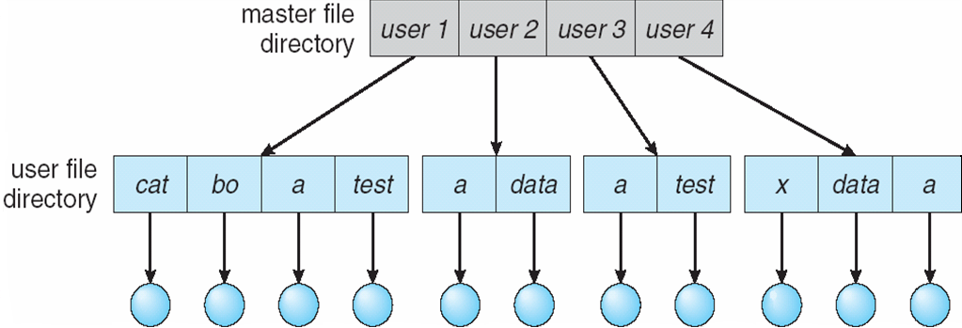
Two-Level Directory
Separate directory for each user
Path name
Can have the same file name for different user
Efficient searching
No grouping capability
Notes:
As we have seen, a single-level directory often leads to confusion of file names among different users. The standard solution is to create a separate directory for each user.
In the two-level directory structure, each user has his own User file directory.
The UFDs have similar structures, but each lists only the files of a single user.
When a user job starts or a user logs in, the system’s master file directory (MFD) is searched. The MFD is indexed by user name or account number, and each entry points to the UFD for that user.
When a user refers to a particular file, only his own UFD is searched. Thus, different users may have files with the same name, as long as all the file names within each UFD are unique.
To create a file for a user, the operating system searches only that user's UFD to ascertain whether another file of that name exists.
To delete a file, the operating system confines its search to the local UFD; thus, it cannot accidentally delete another user's file that has the same name.
The user directories themselves must be created and deleted as necessary. A special system program is run with the appropriate user name and account information. The program creates a new UFD and adds an entry for it to the MFD. The execution of this program might be restricted to system administrators.
Although the two-level directory structure solves the name-collision problem, it still has disadvantages.
This structure effectively isolates one user from another. Isolation is an advantage when the users are completely independent
but is a disadvantage when the users want to cooperate on some task and to access one another's files.
Some systems simply do not allow local user files to be accessed by other users.
If access is to be permitted, one user must have the ability to name a file in another user's directory. To name a particular file “uniquely in a two-level directory, we must give both the user name and the file name.
A two-level directory can be thought of as a tree, or an inverted tree, of height 2. The root
of the tree is the MFD. Its direct descendants are the UFDs. The descendants of the UFDs are the files themselves. The files are the leaves of the tree.
Specifying a user name and a file name defines a path in the tree from the root (the MFD) to a leaf (the specified file). Thus, a user name and a file name define a path name. Every file in the system has a path name. To name a file uniquely, a user
must know the path name of the file desired.
For example, if user A wishes to access her own test file named test, she can simply refer to test. To access the file named test of user B (with directory-entry name userb), however, she might have to refer to /userb/test.
Every system has its own syntax for naming files in directories other than the user's own.

Slide 38
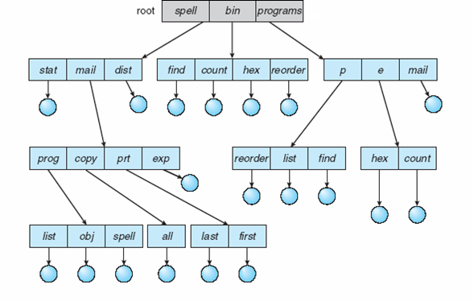
Tree-Structured Directories
Efficient searching
Grouping Capability
Current directory (working directory)
cd /spell/mail/prog
type list
Notes:
Once we have seen how to view a two-level directory as a two-level tree, the natural generalization is to extend the directory structure to a tree of arbitrary height. This generalization allows users to create their own subdirectories and to organize their files accordingly. A tree is the most common directory structure. The tree has a root directory, and every file in the
system has a unique path name.
A directory (or subdirectory) contains a set of files or subdirectories. A directory is simply another file, but it is treated in a special way.
All directories have the same internal format. One bit in each directory entry defines the entry as a file (0) or as a subdirectory (1). Special system calls are used to create and delete directories.
In normal use, each process has a current directory. The current directory should contain most of the files that are of current interest to the process. When reference is made to a file, the current directory is searched. If a file is needed that is not in the current directory, then the user usually must either specify a path name or change the current directory to be the directory holding
that file.
To change directories, a system call is provided that takes a directory name as a parameter and uses it to redefine the current directory. Thus, the user can change his current directory whenever he desires. From one change
directory system call to the next, all open system calls search the current
directory for the specified file. Note that the search path may or may not
contain a special entry that stands for "the current directory."

Slide 39
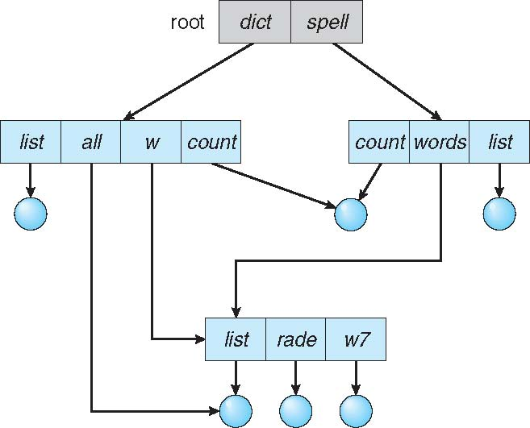
Acyclic-Graph Directories
Have shared subdirectories and files
Notes:
Consider two programmers who are working on a joint project. The files associated
with that project can be stored in a subdirectory, separating them from
other projects and files of the two programmers.
But since both programmers are equally responsible for the project, both want the subdirectory to be in their own directories. The common subdirectory should be shared.
A shared directory or file will exist in the file system in two (or more) places at once.
A tree structure prohibits the sharing of files or directories.
An acyclic graph -that is, a graph with no cycles-allows directories to share subdirectories and files (Figure 10.11).
The same file or subdirectory may be in two different directories. The acyclic graph is a natural generalization of the tree-structured
directory scheme.
It is important to note that a shared file (or directory) is not the same as two copies of the file. With two copies, each programmer can view the copy rather than the original, but if one programmer changes the file, the changes will not appear in the other's copy. With a shared file, only one actual file exists, so any changes made by one person are immediately visible to the other. Sharing is
particularly important for subdirectories; a new file created by one person will automatically appear in all the shared subdirectories.
When people are working as a team, all the files they want to share can be
put into one directory. The UFD of each team member will contain this directory
of shared files as a subdirectory. Even in the case of a single user, the user's file
organization may require that some file be placed in different subdirectories.
For example, a program written for a particular project should be both in the
directory of all programs and in the directory for that project.
Shared files and subdirectories can be implemented in several ways.
A common way, exemplified by many of the UNIX systems, is to create a new
directory entry called a link. A link is effectively a pointer to another file
or subdirectory. For example, a link may be implemented as an absolute or a
relative path name. When a reference to a file is made, we search the directory. If
the directory entry is marked as a link, then the name of the real file is included
in the link information. We resolve the link by using that path name to locate
the real file. Links are easily identified by their format in the directory entry
(or by having a special type on systems that support types) and are effectively indirect pointers.
The operating system ignores these links when traversing
directory trees to preserve the acyclic structure of the system.
Another common approach to implementing shared files is simply to
duplicate all information about them in both sharing directories. Thus, both
entries are identical and equal. Consider the difference between this approach
and the creation of a link. The link is clearly different from the original directory
entry; thus, the two are not equal. Duplicate directory entries, however, make
the original and the copy indistinguishable.
A major problem with duplicate directory entries is maintaining consistency when a file is modified.
An acyclic-graph directory structure is more flexible than is a simple tree
structure, but it is also more complex. Several problems must be considered
carefully. A file may now have multiple absolute path names. Consequently,
distinct file names may refer to the same file. This situation is similar to the
aliasing problem for programming languages. If we are trying to traverse the
entire file system-to find a file, to accumulate statistics on all files, or to copy
all files to backup storage-this problem becomes significant, since we do not
want to traverse shared structures more than once.

Slide 40
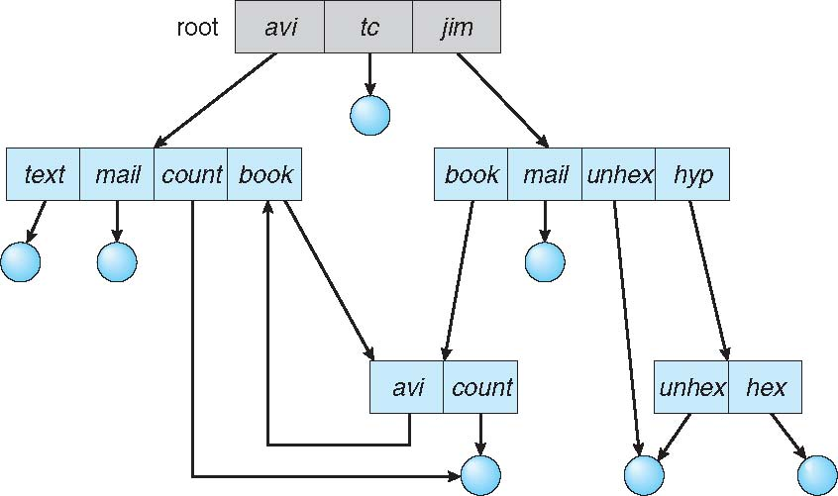
General Graph Directory
Notes:
serious problem with using an acyclic-graph structure is ensuring that there
are no cycles. If we start with a two-level directory and allow users to create
subdirectories, a tree-structured directory results. It should be fairly easy to see
that simply adding new files and subdirectories to an existing tree-structured
directory preserves the tree-structured nature. Howeve1~ when we add links,
the tree structure is destroyed, resulting in a simple graph structure (Figure
10.12).
The primary advantage of an acyclic graph is the relative simplicity of the
algorithms to traverse the graph and to determine when there are no more
references to a file. We want to avoid traversing shared sections of an acyclic
graph twice, mainly for performance reasons. If we have just searched a major
shared subdirectory for a particular file without finding it, we want to avoid
searching that subdirectory again; the second search would be a waste of time.
If cycles are allowed to exist in the directory, we likewise want to
avoid searching any component twice, for reasons of correctness as well as
performance. A poorly designed algorithm might result in an infinite loop
continually searching through the cycle and never terminating. One solution
is to limit arbitrarily the number of directories that will be accessed during a
search.
A similar problem exists when we are trying to determine when a file
can be deleted. With acyclic-graph directory structures, a value of 0 in the
reference count means that there are no more references to the file or directory, and the file can be deleted. However, when cycles exist, the reference count
may not be 0 even when it is no longer possible to refer to a directory or file.
This anomaly results from the possibility of self-referencing (or a cycle) in the
directory structure. In this case, we generally need to use a garbage-collection
scheme to determine when the last reference has been deleted and the disk
space can be reallocated. Garbage collection involves traversing the entire file
system, marking everything that can be accessed. Then, a second pass collects
everything that is not marked onto a list of free space. (A similar marking
procedure can be used to ensure that a traversal or search will cover everything
in the file system once and only once.) Garbage collection for a disk-based file
system, however, is extremely time consuming and is thus seldom attempted.
Garbage collection is necessary only because of possible cycles in the graph.
Thus, an acyclic-graph structure is much easier to work with. The difficulty
is to avoid cycles as new links are added to the structure. How do we know
when a new lir1k will complete a cycle? There are algorithms to detect cycles
in graphs; however, they are computationally expensive, especially when the
graph is on disk storage. A simpler algorithm in the special case of directories
and links is to bypass links during directory traversal. Cycles are avoided, and
no extra overhead is incurred.

Slide 41
File Sharing
Sharing of files on multi-user systems is desirable
Sharing may be done through a protection scheme
On distributed systems, files may be shared across a network
Network File System (NFS) is a common distributed file-sharing method
If multi-user system
User IDs identify users, allowing permissions and protections to be per-user Group IDs allow users to be in groups, permitting group access rights
Owner of a file / directory
Group of a file / directory
Notes:
In the previous sections, we explored the motivation for file sharing and some of
the difficulties involved in allowing users to share files. Such file sharing is very
desirable for users who want to collaborate and to reduce the effort required
to achieve a computing goal. Therefore, user-oriented operating systems must
accommodate the need to share files in spite of the inherent difficulties.
In this section, we examine more aspects of file sharing. We begin by
discussing general issues that arise when multiple users share files. Once
multiple users are allowed to share files, the challenge is to extend sharing to
multiple file systems, including remote file systems; we discuss that challenge
as well. Finally, we consider what to do about conflicting actions occurring on
shared files. For instance, if multiple users are writing to a file, should all the
writes be allowed to occurf or should the operating system protect the users'
actions from one another?
Multiple Users
When an operating system accommodates multiple users, the issues of file
sharing, file naming, and file protection become preeminent. Given a directory
structure that allows files to be shared by users, the system must mediate the
file sharing. The system can either allow a user to access the files of other users
by default or require that a user specifically grant access to the files. These are
the issues of access control and protection, which are covered in Section 10.6.
To implement sharing and protection, the system must maintain more file
and directory attributes than are needed on a single-user system. Although
many approaches have been taken to meet this requirement, most systems
have evolved to use the concepts of file (or directory) owner (or user) and group.
The owner is the user who can change attributes and grant access and who has
the most control over the file. The group attribute defines a subset of users who can share access to the file. For example, the owner of a file on a UNIX system
can issue all operations on a file, while members of the file's group can execute
one subset of those operations, and all other users can execute another subset
of operations. Exactly which operations can be executed by group members
and other users is definable by the file's owner. More details on permission
attributes are included in the next section.
The owner and group IDs of a given file (or directory) are stored with the
other file attributes. When a user requests an operation on a file, the user ID can
be compared with the owner attribute to determine if the requesting user is the
owner of the file. Likewise, the group IDs can be compared. The result indicates
which permissions are applicable. The system then applies those permissions
to the requested operation and allows or denies it.
Many systems have multiple local file systems, including volumes of a
single disk or multiple volumes on multiple attached disks. In these cases,
the ID checking and permission matching are straightforward, once the file
systems are mounted.

Slide 42
File Sharing – Remote File Systems
Uses networking to allow file system access between systems
Manually via programs like FTP
Automatically, seamlessly using distributed file systems
Semi automatically via the world wide web
Client-server model allows clients to mount remote file systems from servers
Server can serve multiple clients
Client and user-on-client identification is insecure or complicated
NFS is standard UNIX client-server file sharing protocol
CIFS is standard Windows protocol
Standard operating system file calls are translated into remote calls
Distributed Information Systems (distributed naming services) such as LDAP, DNS, NIS, Active Directory implement unified access to information needed for remote computing
Notes:
Remote File Systems
With the advent of networks (Chapter 16), communication among remote
computers became possible. Networking allows the sharing of resources spread
across a campus or even around the world. One obvious resource to share is
data in the form of files.
Through the evolution of network and file technology, remote file-sharing
methods have changed. The first implemented method involves manually
transferring files between machines via programs like ftp. The second major
method uses a (DFS) in which remote directories are
visible from a local machine. In some ways, the third method, the
is a reversion to the first. A browser is needed to gain access to the
remote files, and separate operations (essentially a wrapper for ftp) are used
to transfer files.
ftp is used for both anonymous and authenticated access.
allows a user to transfer files without having an account on the remote
system. The World Wide Web uses anonymous file exchange almost exclusively.
DFS involves a much tighter integration between the machine that is accessing
the remote files and the machine providing the files. This integration adds
complexity, which we describe in this section.
The Client-Server Model
Remote file systems allow a computer to mom1.t one or more file systems
from one or more remote machines. In this case, the machine containing the
files is the server, and the machine seeking access to the files is the client. The
client-server relationship is common with networked machines. Generally,
the server declares that a resource is available to clients and specifies exactly
which resource (in this case, which files) and exactly which clients. A server
can serve multiple clients, and a client can use multiple servers, depending on
the implementation details of a given client-server facility.
The server usually specifies the available files on a volume or directory
level. Client identification is more difficult. A client can be specified
network name or other identifier, such as an IP address, but these can be spoofed or imitated. As a result of spoofing, an unauthorized client could be allowed
access to the server. More secure solutions include secure authentication of the
client via encrypted keys. Unfortunately, with security come many challenges,
including ensuring compatibility of the client and server (they must use the
same encryption algorithms) and security of key exchanges (intercepted keys
could again allow unauthorized access). Because of the difficulty of solving
these problems, unsecure authentication methods are most commonly used.
In the case of UNIX and its network file system (NFS), authentication takes
place via the client networking information, by default. In this scheme, the
user's IDs on the client and server must match. lf they do not, the server will
be unable to determine access rights to files. Consider the example of a user
who has an ID of 1000 on the client and 2000 on the server. A request from
the client to the server for a specific file will not be handled appropriately, as
the server will determine if user 1000 has access to the file rather than basing
the determination on the real user ID of 2000. Access is thus granted or denied
based on incorrect authentication information. The server must trust the client
to present the correct user ID. Note that the NFS protocols allow many-to-many
relationships. That is, many servers can provide files to many clients. In fact
a given machine can be both a server to some NFS clients and a client of other
NFS servers.
Once the remote file system is mounted, file operation requests are sent
on behalf of the user across the network to the server via the DFS protocol.
Typically, a file-open request is sent along with the ID of the requesting user.
The server then applies the standard access checks to determine if the user has
credentials to access the file in the mode requested. The request is either allowed
or denied. If it is allowed, a file handle is returned to the client application,
and the application then can perform read, write, and other operations on the
file. The client closes the file when access is completed. The operating system
may apply semantics similar to those for a local file-system mount or may use
different semantics.
Distributed Information Systems
To make client-server systems easier to manage,
also known as provide unified access
to the information needed for remote computing. The
provides host-name-to-network-address translations for the entire
Internet (including the World Wide Web). Before DNS became widespread,
files containing the same information were sent via e-mail or ftp between all
networked hosts. This methodology was not scalable. DNS is further discussed
in Section 16.5.1.
Other distributed information systems provide user name/password/user
ID/group ID space for a distributed facility. UNIX systems have employed a wide
variety of distributed-information methods. Sun Microsystems introduced
yellow pages (since renamed or and most of
the industry adopted its use. It centralizes storage of user names, host names,
printer information, and the like. Unfortunately, it uses unsecure authentication
methods, including sending user passwords unencrypted (in clear text) and
identifying hosts by IP address. Sun's NIS+ is a much more secure replacement
for NIS but is also much more complicated and has not been widely adopted.
In the case of Microsoft’s common Internet file system (CIFS), network
information is used in conjunction with user authentication (user name and
password) to create a that the server uses to decide whether
to allow or deny access to a requested file system. For this authentication
to be valid, the user names m.u.st match from machine to machine (as with
NFS). Microsoft uses two distributed naming structures to provide a single
name space for users. The older naming technology is The newer
technology, available in Windows XP and Windows 2000, is
Once established, the distributed naming facility is used by all clients
servers to authenticate users.
The industry is moving toward use of the
as a secure distributed naming mechanism. In fact, active
is based on LDAP. Sun Microsystems includes LDAP with the
operating system and allows it to be employed for user authentication as
well as system-wide retrieval of information, such as availability of printers.
Conceivably, one distributed LDAP directory could be used by an organization
to store all user and resource information for all the organization's computers.
The result would be for users, who would enter
their authentication information once for access to all computers within the
organization. It would also ease system-administration efforts by combining,
in one location, information that is currently scattered in various files on each
system or in different distributed information services.

Slide 43
File Sharing – Failure Modes
All file systems have failure modes
For example corruption of directory structures or other non-user data, called metadata
Remote file systems add new failure modes, due to network failure, server failure
Recovery from failure can involve state information about status of each remote request
Stateless protocols such as NFS v3 include all information in each request, allowing easy recovery but less security
Notes:
Local file systems can fail for a variety of reasons, including failure of the
disk containing the file system, corruption of the directory structure or other
disk-management information (collectively called disk-controller
failure, cable failure, and host-adapter failure. User or system-administrator
failure can also cause files to be lost or entire directories or volumes to be
deleted. Many of these failures will cause a host to crash and an error condition
to be displayed, and human intervention will be required to repair the damage.
Remote file systems have even more failure modes. Because of the
complexity of network systems and the required interactions between remote
machines, many more problems can interfere with the proper operation of
remote file systems. In the case of networks, the network can be interrupted
between two hosts. Such interruptions can result from hardware failure, poor
hardware configuration, or networking implementation issues. Although some
networks have built-in resiliency, including multiple paths between hosts,
many do not. Any single failure can thus interrupt the flow of DFS commands.
Consider a client in the midst of using a remote file system. It has files open
from the remote host; among other activities, it may be performing directory
lookups to open files, reading or writing data to files, and closing files. Now
consider a partitioning of the network, a crash of the server, or even a scheduled
shutdown of the server. Suddenly, the remote file system is no longer reachable.
This scenario is rather common, so it would not be appropriate for the client
system to act as it would if a local file system were lost. Rather, the system can
either terminate all operations to the lost server or delay operations until the
server is again reachable. These failure semantics are defined and in<plemented
as part of the remote-file-system protocol. Termination of all operations can result in users' losing data-and patience. Thus, most DFS protocols either
enforce or allow delaying of file-system operations to rencote hosts, with the
hope that the remote host will become available again.
To implement this kind of recovery from failure, some kind of
may be maintained on both the client and the server. If both server
and client maintain knowledge of their current activities and open files, then
they can seamlessly recover from a failure. In the situation where the server
crashes but must recognize that it has remotely rnounted exported file systems
and opened files, NFS takes a simple approach, implementing a DFS.
In essence, it assumes that a client request for a file read or write would not
have occurred unless the file system had been remotely mounted and the file
had been previously open. The NFS protocol carries all the information needed
to locate the appropriate file and perform the requested operation. Similarly,
it does not track which clients have the exported volumes mounted, again
assuming that if a request comes in, it must be legitimate. While this stateless
approach makes NFS resilient and rather easy to implement, it also makes it
unsecure. For example, forged read or write requests could be allowed by an
NFS server even though the requisite mount request and permission check
had not taken place. These issues are addressed in the industry standard NFS
Version 4, in which NFS is made stateful to improve its security, performance,
and functionality.

Slide 44
File Sharing – Consistency Semantics
Specify how multiple users are to access a shared file simultaneously
Similar to Module 3: Process Synchronization
Tend to be less complex due to disk I/O and network latency (for remote file systems
Andrew File System (AFS) implemented complex remote file sharing semantics
Unix file system (UFS) implements:
Writes to an open file visible immediately to other users of the same open file
Sharing file pointer to allow multiple users to read and write concurrently
AFS has session semantics
Writes only visible to sessions starting after the file is closed
Notes:
Consistency Semantics
represent an important criterion for evaluating any
file system that supports file sharing. These semantics specify how multiple
users of a system are to access a shared file simultaneously. In particular, they
specify when modifications of data by one user will be observable by other
users. These semantics are typically implemented as code with the file system.
Consistency semantics are directly related to the process-synchronization
algorithms of Chapter 6. However, the complex algorithms of that chapter tend
not to be implemented in the case of file I/0 because of the great latencies and
slow transfer rates of disks and networks. For example, performing an atomic
transaction to a remote disk could involve several network communications,
several disk reads and writes, or both. Systems that attempt such a full set of
functionalities tend to perform poorly. A successful implementation of complex
sharing semantics can be found in the Andrew file system.
For the following discussion, we assume that a series of file accesses (that
is, reads and writes) attempted by a user to the same file is always enclosed
between the open() and close() operations. The series of accesses between
the open() and close() operations makes up a To illustrate the
concept, we sketch several prominent examples of consistency semantics.
UNIX Semantics
The UNIX file system (Chapter 17) uses the following consistency semantics:
Writes to an open file by a user are visible immediately to other users who
have this file open.
One mode of sharing allows users to share the pointer of current location
into the file. Thus, the advancing of the pointer by one user affects all
sharing users. Here, a file has a single image that interleaves all accesses,
regardless of their origin.
In the UNIX semantics, a file is associated with a single physical image that
is accessed as an exclusive resource. Contention for this single image causes
delays in user processes.
10.5.3.2 Session Semantics
The Andrew file system (AFS) (Chapter 17) uses the following consistency
semantics:
Writes to an open file by a user are not visible immediately to other users
that have the same file open.
Once a file is closed, the changes made to it are visible only in sessions
starting later. Already open instances of the file do not reflect these changes.
According to these semantics, a file may be associated temporarily with several
(possibly different) images at the same time. Consequently, multiple users are
allowed to perform both read and write accesses concurrently on their images
of the file, without delay. Almost no constraints are enforced on scheduling
accesses.
10.5.3.3 Immutable-Shared-Files Semantics
A unique approach is that of Once a file is declared
as shared by its creator, it cam1ot be modified. An immutable £ile has two key
properties: its name may not be reused, and its contents may not be altered.
Thus, the name of an immutable file signifies that the contents of the file are
fixed. The implementation of these semantics in a distributed system (Chapter
17) is simple, because the sharing is disciplined (read-only).

Slide 45
Thank You

